Slide 1
Space Packet Structural Components
SPACE PACKET
PACKET DATA FIELD
PACKET PRIMARY HEADER
PACKET SECONDARY HEADER
USER DATA FIELD
Variable
Variable
6 octets
1 to 65536 octets

Slide 2
Packet Primary Header – Bit-fields
PACKET PRIMARY HEADER
3
PACKET IDENTIFICATION
PACKET SEQUENCE CONTROL
PACKET VERSION NUMBER
PACKET DATA LENGTH
SEC. HDR. FLAG
APPLICATION PROCESS IDENTIFIER
PACKET SEQUENCE COUNT OR PACKET NAME
SEQUENCE FLAGS
PACKET TYPE
3 bits
1 bit
1 bit
11 bits
2 bits
14 bits
16 bits
2 octets
2 octets
2 octets

Slide 3
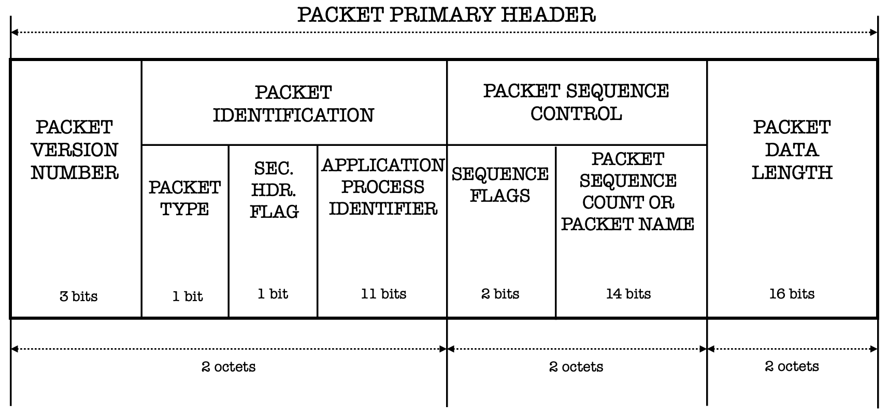
Field descriptions
PACKET VERSION NUMBER:
- ‘000’ identifies data unit as a Space Packet
PACKET DATA LENGTH:
- Contains the length count, C, that is one fewer than the length of the Packet Data Field
PACKET TYPE:
- ‘0’ for telemetry (or reporting)
- ‘1’ for telecommand (or requesting)
PACKET SEQUENCE COUNT OR PACKET NAME:
- Sequential binary count of each Space Packet generated by the user application identified by the APID.
SECONDARY HEADER FLAG:
- Indicates presence of a Packet Secondary Header
- ‘0’ no Packet Secondary Header
- ‘1’ Packet Secondary Header present
SEQUENCE FLAGS:
- ‘00’ if SP contains continuation segment of User Data
- ‘01’ if SP contains first segment of User Data
- ‘10’ if SP contains last segment of User Data
- ‘11’ if SP contains unsegmented User Data
APPLICATION PROCESS IDENTIFIER:
Provides a naming mechanism for the managed data path.

Slide 4
Packet Primary Header – Byte-fields
PACKET PRIMARY HEADER
3
PACKET IDENTIFICATION
PACKET SEQUENCE CONTROL
PACKET VERSION NUMBER
PACKET DATA LENGTH
SEC. HDR. FLAG
APPLICATION PROCESS IDENTIFIER
PACKET SEQUENCE COUNT OR PACKET NAME
SEQUENCE FLAGS
PACKET TYPE
1 byte:
0x00 – 0x01
1 byte: 0x00 – 0x01
2 bytes:
0x0000 – 0xFFFF
1 byte: 0x00 – 0x03
2 bytes: 0x0000 – 0xFFFF
2 bytes: 0x0000 – 0xFFFF
1 byte:
0x00
5 bytes
3 bytes
2 bytes

Slide 5
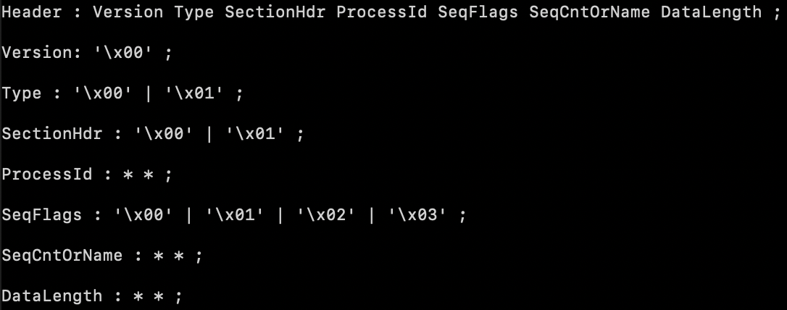
XBNF Grammar

Slide 6
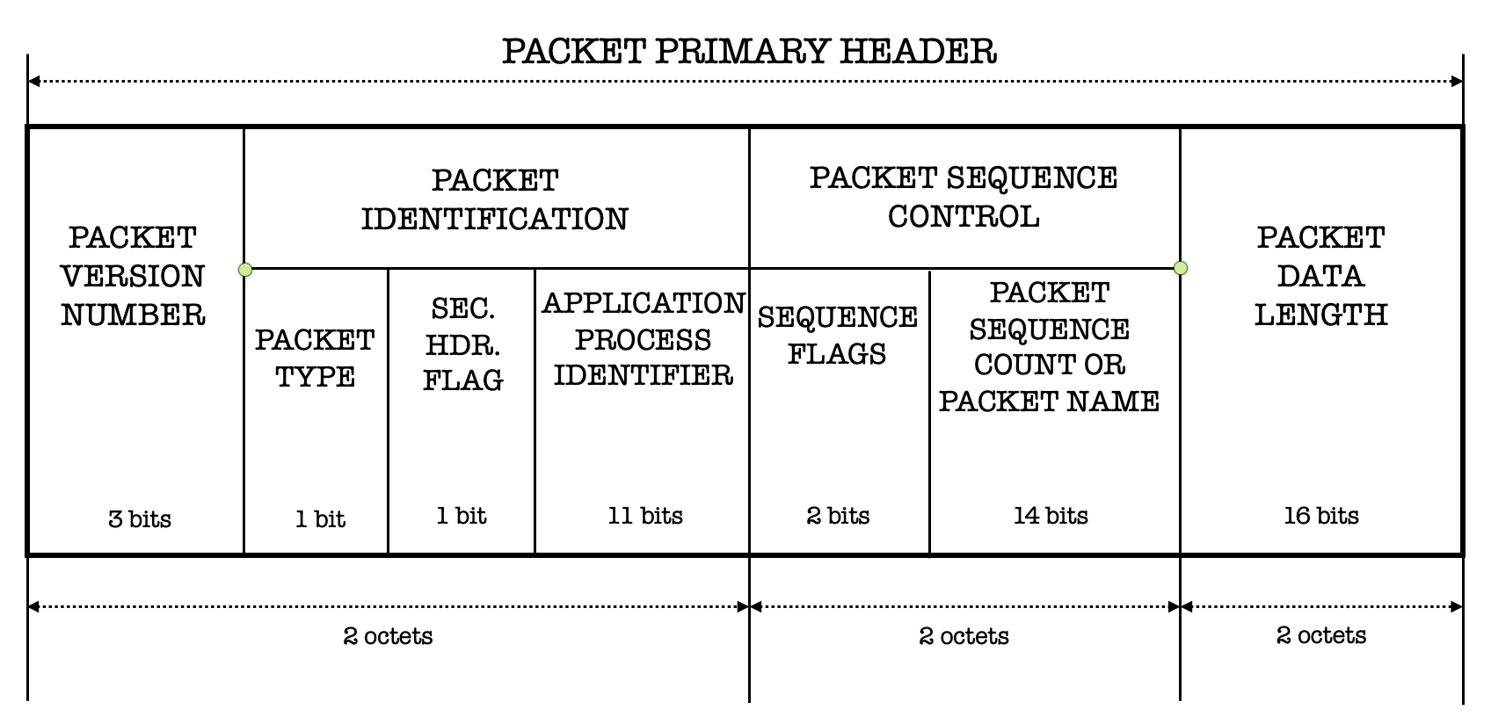
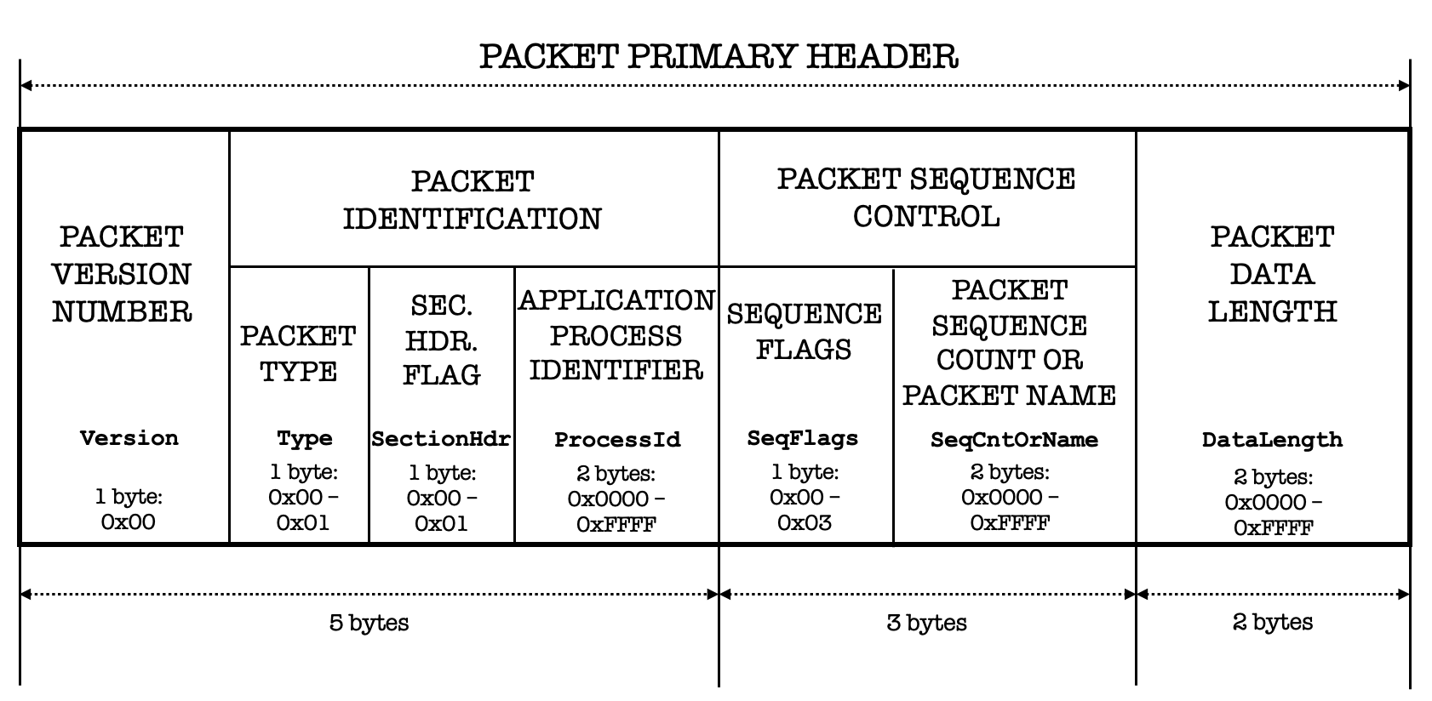
Bit-field SPP header:
Byte-field SPP header:
XBNF Grammar:

Slide 7
Screenshot for previous slide
PACKET PRIMARY HEADER
3
PACKET IDENTIFICATION
PACKET SEQUENCE CONTROL
PACKET VERSION NUMBER
PACKET DATA LENGTH
SEC. HDR. FLAG
APPLICATION PROCESS IDENTIFIER
PACKET SEQUENCE COUNT OR PACKET NAME
SEQUENCE FLAGS
PACKET TYPE
Version
Type
SectionHdr
ProcessId
SeqFlags
SeqCntOrName
DataLength
1 byte:
0x00 – 0x01
1 byte: 0x00 – 0x01
2 bytes:
0x0000 – 0xFFFF
1 byte: 0x00 – 0x03
2 bytes: 0x0000 – 0xFFFF
2 bytes: 0x0000 – 0xFFFF
1 byte:
0x00
5 bytes
3 bytes
2 bytes

